Slide 1
Palantir
September, 2018

Slide 2
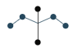


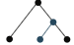

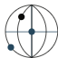


Palantir Products and Technology
GOTHAM
Federated querying capabilities and enterprise data integration using any form of data
APIs for integrating various pictographs generated from analysis into external applications
Plug-in solutions that are flexible, modular and easily customisable for organisation-wide use with consistent data collaboration
Widely used by the US Government for law enforcement, defence, etc. and in industries like automotive, aviation and pharma
PHOENIX
Clusterable data store
DYNAMIC ONTOLOGY
Data objects & associations
RAPTOR
Federated Searching
REVISIONING DB
Persistent Data Store
SEARCH
Full-text querying
ATLASDB
Container for RevDB
HORIZON
In-memory database
NEXUS PEERING
Syncrhnonization of Systems
FOUNDRY
Powerful data integration capabilities that covers enterprise-level data in any size and shape.
Its USP lies not only in offering to merge data from a wide range of sources but also absorbs every output from the integration/analysis as a new data source in itself.
Utilizes data as well as metadata in form of provenance, versioning and transformation.
Drives organizations from various domains to increase efficacy by focusing more on analysis than data integration

Slide 3
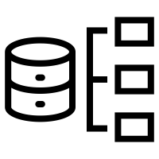

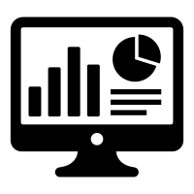




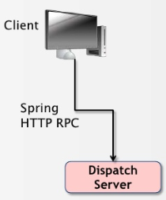

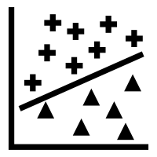







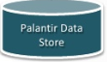



Application and Analytical Architecture
Palantir
Custom Application
Analytics
Client Connection API provides the link for Searching and Extraction of Entity Objects
Unstructured or Structured Data Collaboration and Storage API’s from different sources
Hercules API
Automated Analysis
Anomaly Detection
Behavioral Pattern Recognition
Ranked Clustering
Programmatically Query, Modify, Export Information into the application
Processing, Data Management and Transformation into Palantir Data Store (ETL) as Objects
Application - Blueprint, Django & REST
Visualizations and Reporting – Plottable , D3 JS

Slide 4

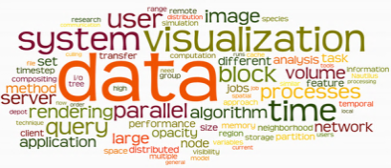
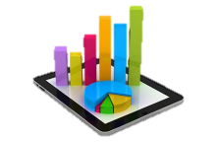
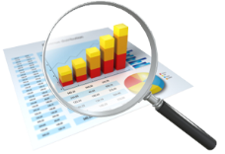
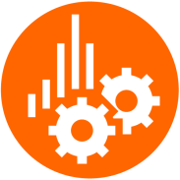












LatentView – Technical Stack
Analytics Tools
Visualization
Exec. Dashboards, Integrated Marketing & Social Media Dashboards,
Infographics
Reporting
Canned Reports Development & Refresh, Ad-hoc Reporting, Data Pulls
Data Exploration
Root Cause Analysis, Unstructured Data Analysis, Segmentation,
Text mining,
Predictive Models,
Optimization,
Experiment Design
Reporting
Advanced Analytics
Reporting & Insights
Visualization
Big Data Tools
Analytics & Reporting Data Marts
Online
Web Analytics, Ad exchanges
APIs, Scheduled Reports
Social
Twitter, Facebook, YouTube, Pinterest
API, Aggregators (Datasift, Gnip), Listening Tools (Radian6)
Traditional Data Warehouse
Data Lakes
NoSQL Data Stores
Data Aggregation
Syndicate
Custom data integration
Nielsen, Rentrak, ComScore, GFK
Internal
ETL, Enterprise Service Bus, Streaming
Financial, Marketing
HR, Supply Chain

Slide 5
Thank you

